Slide 1


Web Study Jams

Slide 2
Web Dev What ?
😒
Web development is the art of creating functional and beautiful web apps for the internet .

Slide 3
Web Dev Why ?
😉
Everlasting demand.
Growing power of the browsers.
Reach !
Time tested.
Update(s)d , always.

Slide 4

What we’ll cover ?
Intro to web development
Networking basics
Github & Git basics
HTML & CSS
Javascript
Lightning Talks

Slide 5
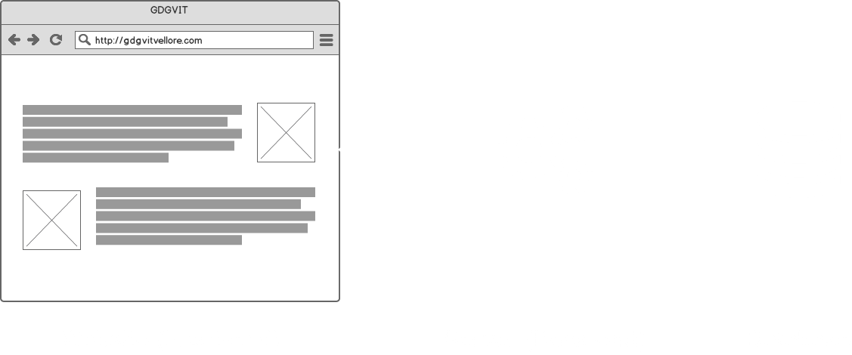
Intro to web development

Slide 6
Intro to web development
Front-end
HTML
CSS
JavaScript

Slide 7
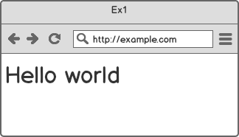
HTML
HTML - Hyper text markup language
Made up of tags
Tags are nested
Example:
<p>Hello world</p>

Slide 8
HTML - Tags
<p>Hello world</p>
Open Tag
Body
Close Tag

Slide 9
HTML - Tags
Html -
Head -
Body -
Heading -
Para -
style
image
link
input
textarea
button
list
div
span

Slide 10
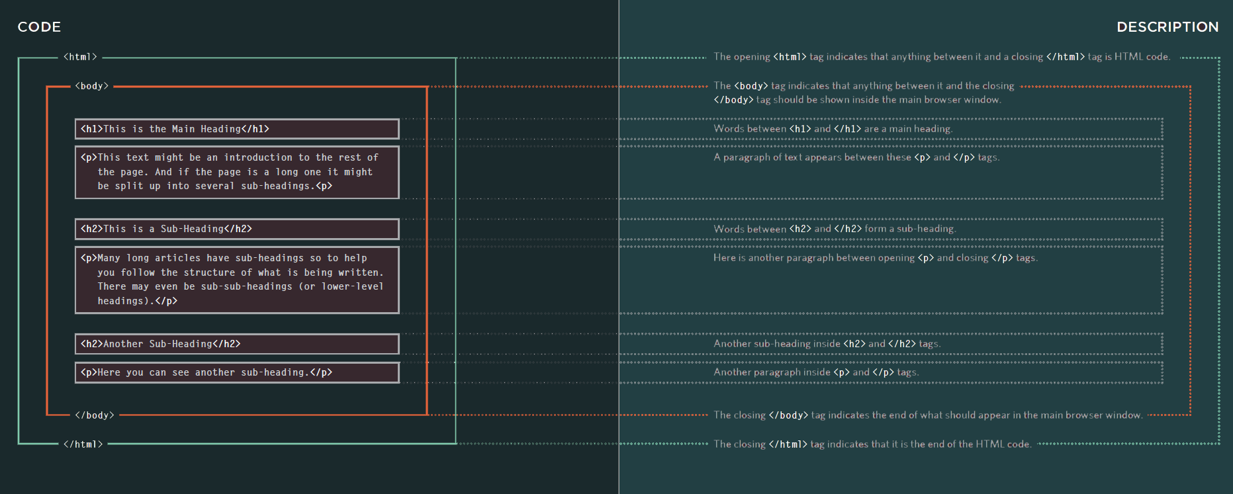
HTML - Tags

Slide 11
HTML - Attributes
id
class
href
style

Slide 12

Side Task

Slide 13

Side Task

Slide 14
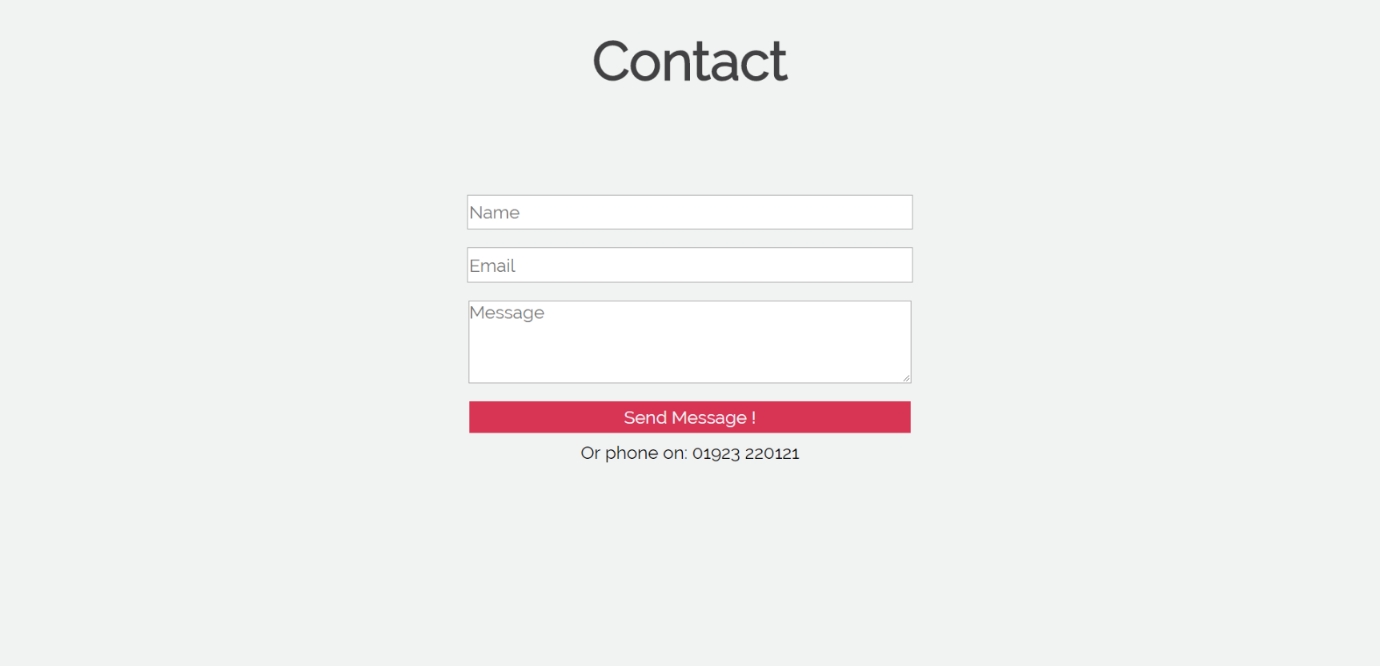
Side Task

Slide 15
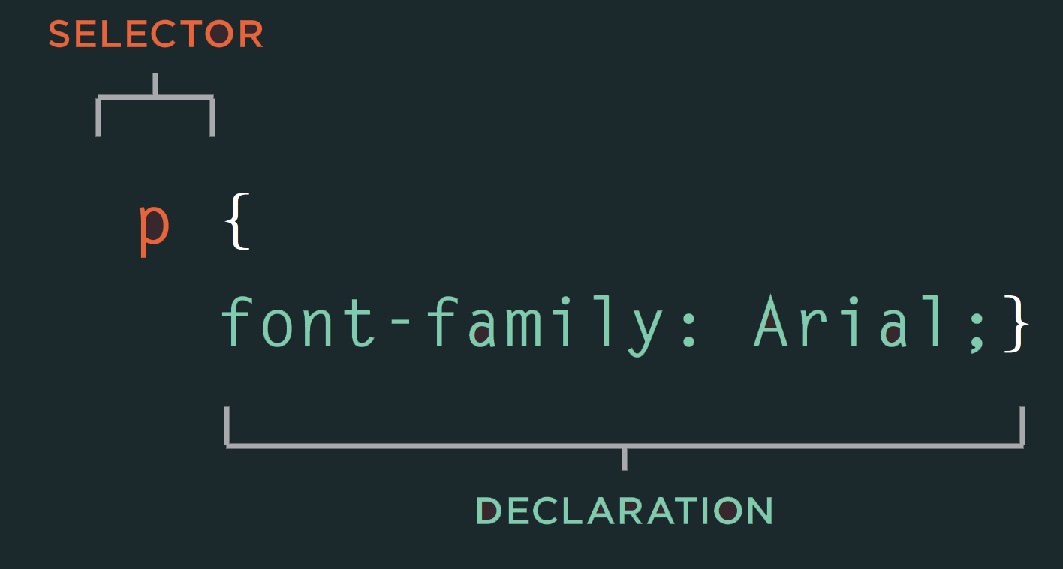
Cascading Style Sheets (CSS)

Slide 16
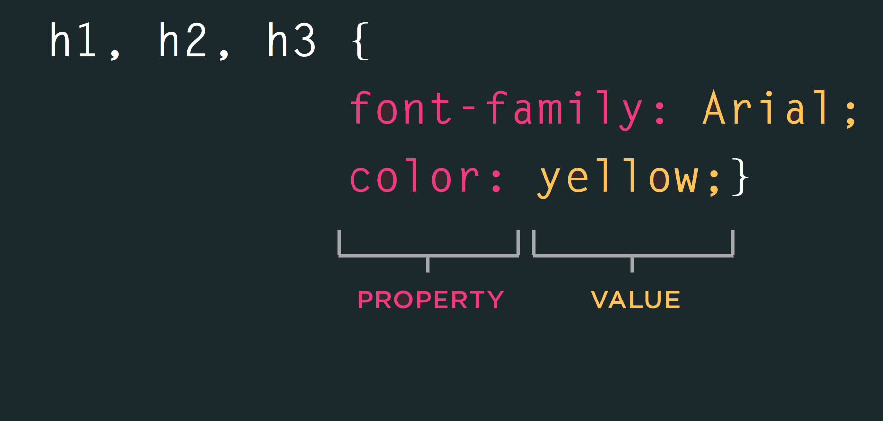
css

Slide 17
css properties
Colours
font styles
DOM introduction
Margin
Padding
Border
Height
Width

Slide 18
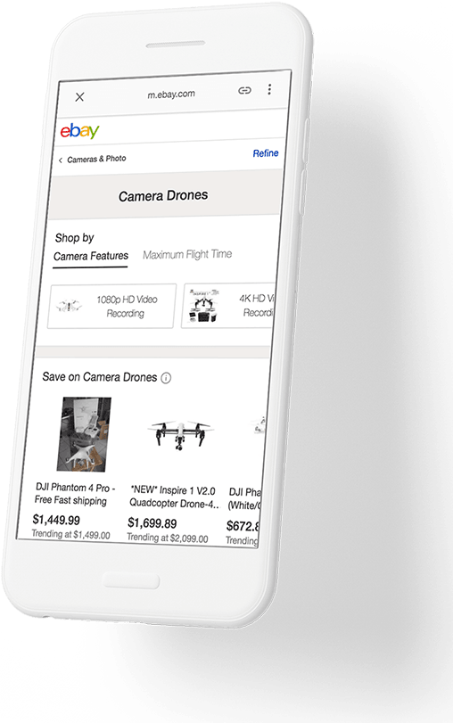
Web Dev Woah !
Accelerated Mobile Pages (AMP)
Lightning fast load times on mobiles
Robust feel even on slow networks
Optimised to be silky smooth

Slide 19
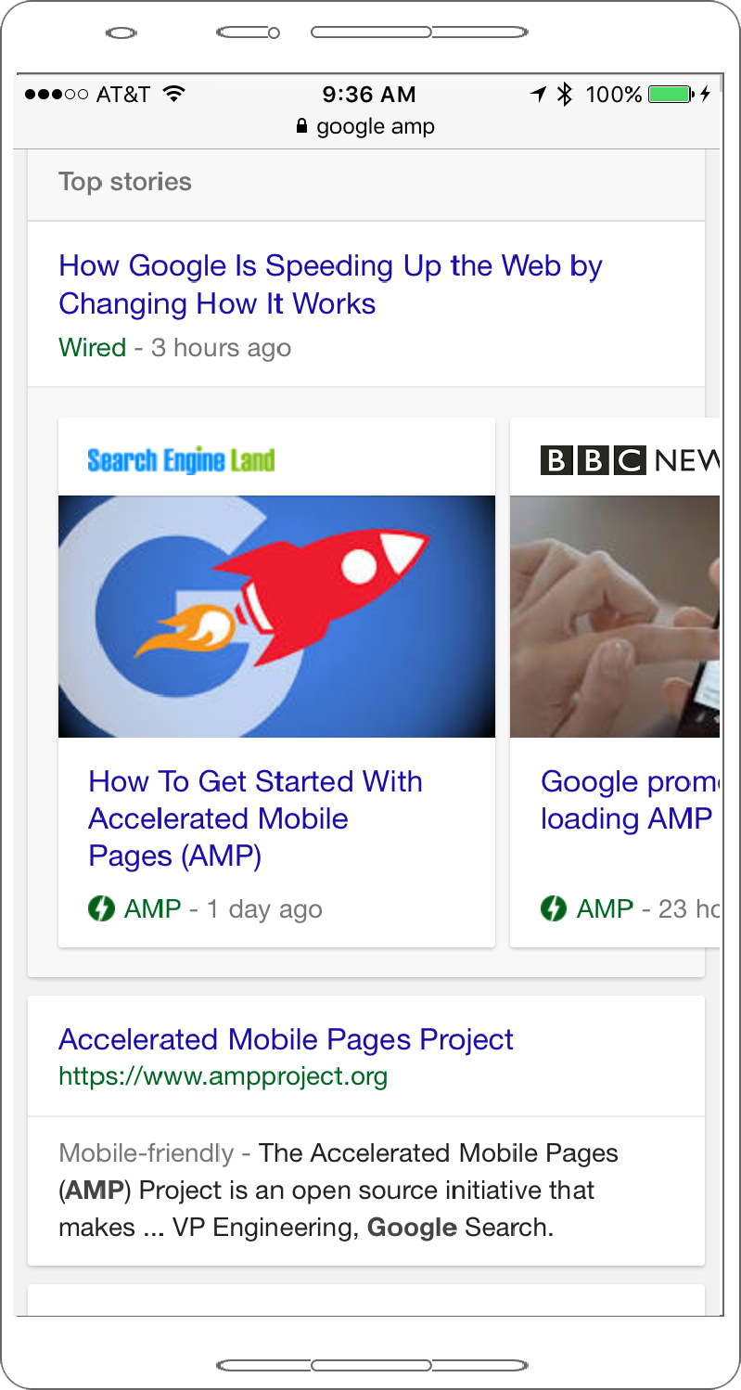
Web Dev Woah !
AMP indexing by google

Slide 20

Web Dev Woah !
Progressive Web Apps (PWAs)
Offline support
Responsive
App-like feel ,no lags
Re-engagement first design
Discoverable

Slide 21
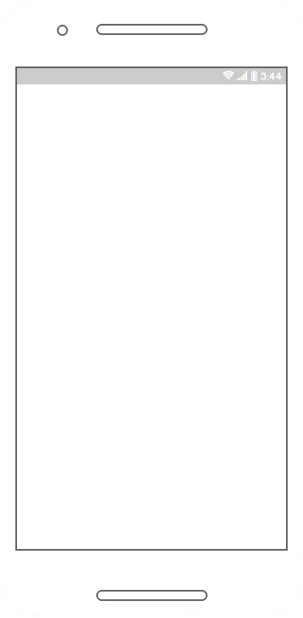
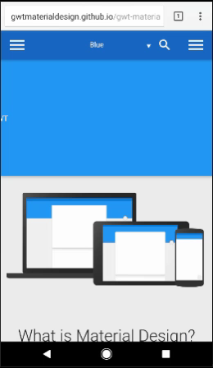
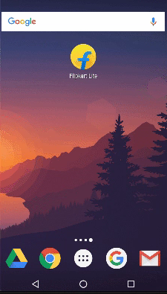
Web Dev Woah !
PWA how do they actually feel ?

Slide 22
Web Dev Woah !
Who uses PWAs ?
65 % increase in pages per session
75% increase in tweets sent
20% decrease in bounce rate

